Slide 1


Kamil Chłosta
18nd October 2022

Slide 2

Outline
Executive Summary
Introduction
Methodology
Results
Conclusion
Appendix

Slide 3
Executive Summary
Summary of methodologies
Data collection (web scraping)
Data wrangling
EDA with data visualization (seaborn python module)
EDA with SQL (using sqlite)
Building an interactive map with Folium
Building a Dashboard with Plotly and Dash
Predictive analysis (classification problem)
Summary of all results
EDA results
Interactive analytics
Predictive analysis

Slide 4
Introduction
Project background and context
Space X advertises Falcon 9 rocket launches on its website with a cost of 62 million dollars; other providers cost upward of 165 million dollars each, much of the savings is because Space X can reuse the first stage. Therefore, if we can determine if the first stage will land, we can determine the cost of a launch. This information can be used if an alternate company wants to bid against space X for a rocket launch. This goal of the project is to create a machine learning pipeline to predict if the first stage will land successfully.
Problems you want to find answers
The project task is to predict whether the first stage of the SpaceX Falcon 9 rocket will land successfully. The interaction amongst various features that determine the success rate of a successful landing.
What operating conditions needs to be in place to ensure a successful landing program?

Slide 5


Slide 6
Methodology
Executive Summary
Data collection methodology:
SpaceX Rest API
Web Scrapping from Wikipedia
Perform data wrangling
Data cleaning, imputation and lastly One Hot Encoding have been performed
Perform exploratory data analysis (EDA) using visualization and SQL
Perform interactive visual analytics using Folium and Plotly Dash
Perform predictive analysis using classification models
Logistic Regression, KNN, SVM and Decision Trees models have been implemented and evaluated and compared to find the best classifier

Slide 7
Data Collection
The data was collected using various methods
Data collection was done using get request to the SpaceX API.
Next, we decoded the response content as a Json using .json() function call and turn it into a pandas dataframe using .json_normalize().
We then cleaned the data, checked for missing values and fill in missing values where necessary.
In addition, we performed web scraping from Wikipedia for Falcon 9 launch records with BeautifulSoup.
The objective was to extract the launch records as HTML table, parse the table and convert it to a pandas dataframe for future analysis.

Slide 8

Data Collection – SpaceX API
We used the get request to the SpaceX API to collect data, clean the requested data and did some basic data wrangling and formatting.
The link to the notebook is here.

Slide 9

Data Collection - Scraping
Falcon 9 launch records have been web-scrapped using BeautifulSoup Python module
The table has been parsed and converted into pandas dataframe.
The link to the notebook is here.

Slide 10

Data Wrangling
Exploratory data analysis has been performed and the training labels have been determined
The number of launches at each site and the number and occurrence of each orbits have been calculated
Landing outcome label from outcome column have been determined and the results have been exported to csv.
The link to the notebook is here.

Slide 11


EDA with Data Visualization
The data has been explored by visualizing the relationship between flight number and launch Site, payload and launch site, success rate of each orbit type, flight number and orbit type, the launch success yearly trend.
The link to the notebook is https://github.com/chuksoo/IBM-Data-Science-Capstone-SpaceX/blob/main/EDA%20with%20Data%20Visualization.ipynb

Slide 12
EDA with SQL
The SpaceX dataset has been loaded into a PostgreSQL database inside of the jupyter notebook.
EDA with SQL has been applied to get insight from the data. SQL queries have been executed to find out for example:
The names of unique launch sites in the space mission.
The total payload mass carried by boosters launched by NASA (CRS)
The average payload mass carried by booster version F9 v1.1
The total number of successful and failure mission outcomes
The failed landing outcomes in drone ship, their booster version and launch site names.
The link to the notebook is here.

Slide 13
Build an Interactive Map with Folium
marked all launch sites, and added map objects such as markers, circles, lines to mark the success or failure of launches for each site on the folium map
assigned the feature launch outcomes (failure or success) to class 0 and 1.i.e., 0 for failure, and 1 for success
Using the color-labeled marker clusters, identified which launch sites have relatively high success rate
calculated the distances between a launch site to its proximities
answered some question for instance:
if launch sites are near railways, highways and coastlines.
Do launch sites keep certain distance away from cities?

Slide 14
Build a Dashboard with Plotly Dash
an interactive dashboard with Plotly dash has been built
pie charts showing the total launches by a certain sites have been plotted
scatter graph showing the relationship with Outcome and Payload Mass (Kg) for the different booster version have been plotted
the link to the app code is here.

Slide 15
Predictive Analysis (Classification)
loaded the data using numpy and pandas, transformed the data, split data into training and testing.
built different machine learning models and tuned hyperparameters using GridSearchCV.
used accuracy as the metric for our model, improved the model using feature engineering and algorithm tuning.
found the best performing classification model.
The link to the notebook is here.

Slide 16
Results
Exploratory data analysis results
Interactive analytics demo in screenshots
Predictive analysis results

Slide 17


Slide 18

Flight Number vs. Launch Site
the larger the flight amount at a launch site, the greater the success rate at a launch site.

Slide 19

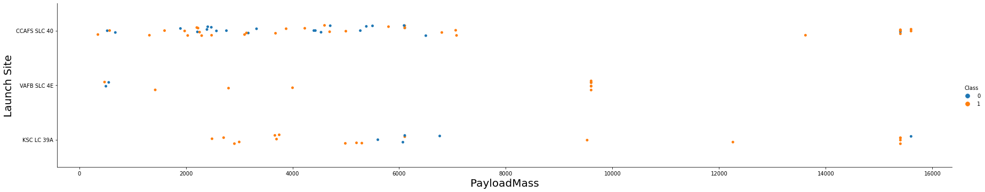
Payload vs. Launch Site

Slide 20
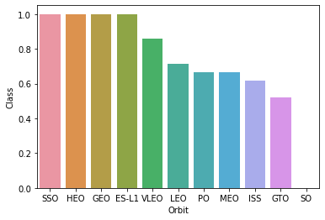
Success Rate vs. Orbit Type
ES-L1, GEO, HEO, SSO, VLEO orbits have the best success rate.
The SO orbit has the worst success rate (only failures)

Slide 21
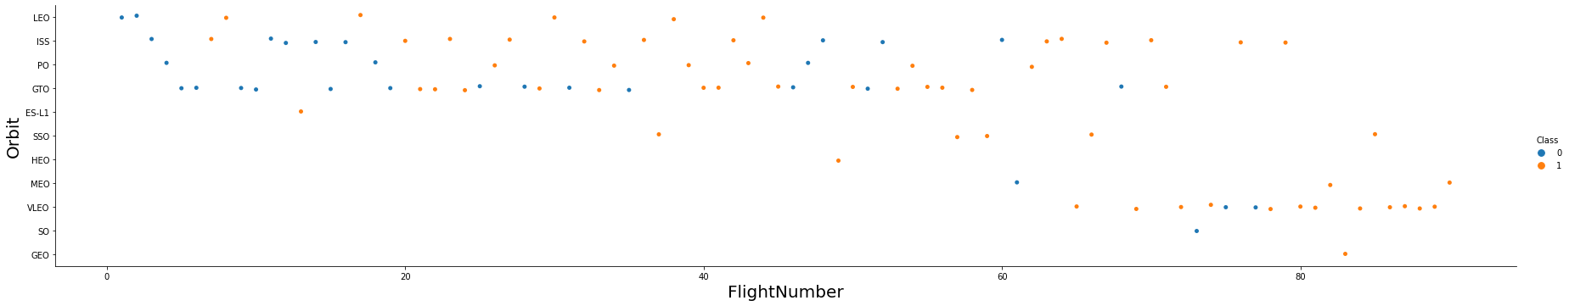
Flight Number vs. Orbit Type
in the LEO orbit, success is related to the number of flights
in the GTO orbit, there is no relationship between flight number and the success rate

Slide 22

Payload vs. Orbit Type
with heavy payloads, the successful landings are more likely to happen for PO, LEO and ISS orbits.

Slide 23
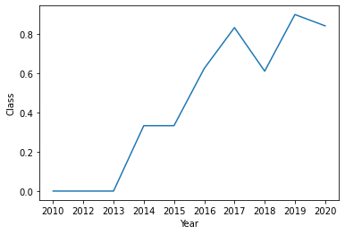
Launch Success Yearly Trend
success rate kept on increasing since 2013 till 2020 apart from slight setback in 2018

Slide 24
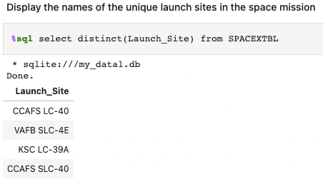
All Launch Site Names
Used SQL DISTINCT to show only unique launch sites from the SpaceX data.

Slide 25
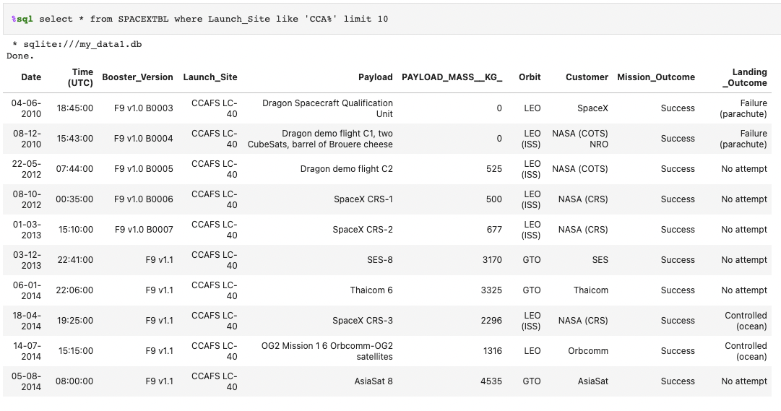
Launch Site Names Begin with 'CCA'
10 records where launch sites begin with `CCA`

Slide 26
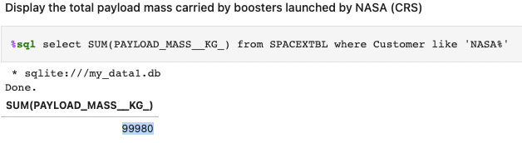
Total Payload Mass
calculated the total payload carried by boosters from NASA as 99980 kg

Slide 27

Average Payload Mass by F9 v1.1
the average payload mass carried by booster version F9 v1.1: 2928.4 kg

Slide 28
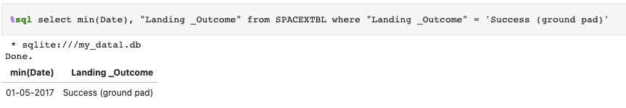
First Successful Ground Landing Date
the date of the first successful landing outcome on ground pad was 01st May 2017

Slide 29
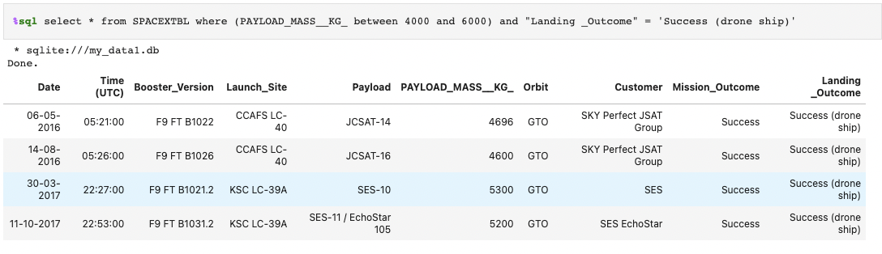
Successful Drone Ship Landing with Payload between 4000 and 6000
used the WHERE clause to filter for boosters which have successfully landed on drone ship and applied the AND condition to determine successful landing with payload mass greater than 4000 but less than 6000

Slide 30
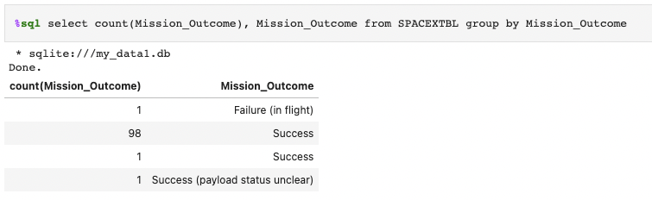
Total Number of Successful and Failure Mission Outcomes
used Group By the Mission Outcome to see number of successes and failures.

Slide 31
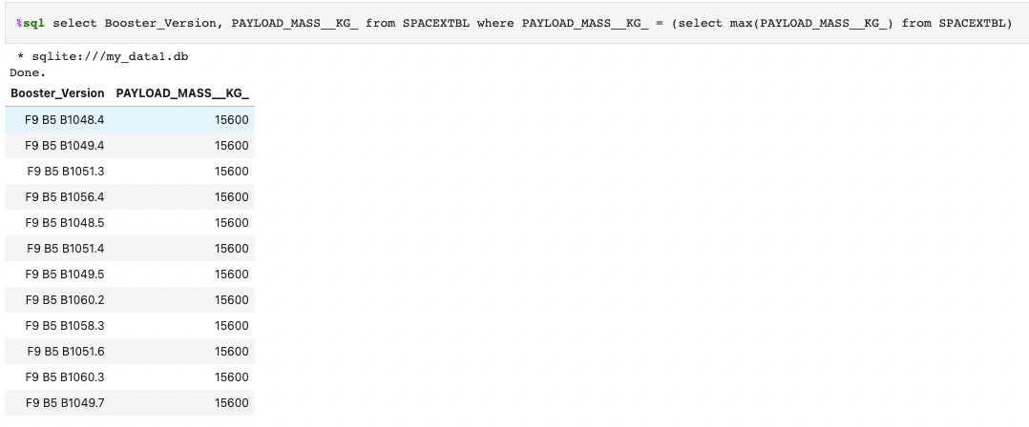
Boosters Carried Maximum Payload
determined the booster that carried the maximum payload using a subquery in the WHERE clause and the MAX() function

Slide 32
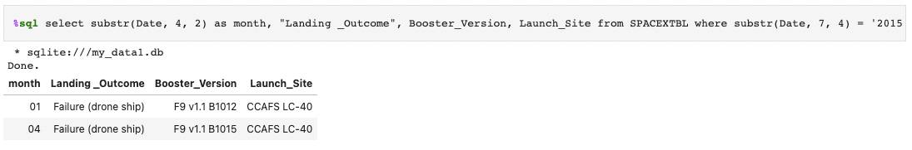
2015 Launch Records
Listed the records which will display the month names, failure landing outcomes in drone ship, booster versions, launch site for the months in year 2015

Slide 33
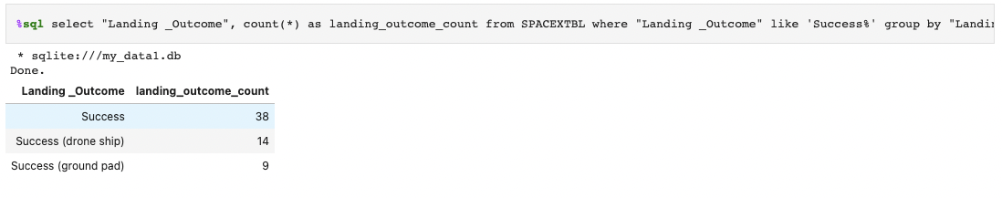
Rank Landing Outcomes Between 2010-06-04 and 2017-03-20
Ranked the count of successful landing outcomes between the date 04-06-2010 and 20-03-2017 in descending order.

Slide 34


Slide 35

All launch sites global map markers

Slide 36

Markers showing launch sites with color labels

Slide 37

Launch Site distance to landmarks

Slide 38


Slide 39

Pie chart showing the success percentage achieved by each launch site

Slide 40

Pie chart showing the Launch site with the highest launch success ratio

Slide 41

Scatter plot of Payload vs Launch Outcome for all sites, with different payload selected in the range slider

Slide 42


Slide 43

Classification Accuracy
The decision tree classifier is the model with the highest classification accuracy

Slide 44

Confusion Matrix
The confusion matrix for the decision tree classifier shows that the classifier can distinguish between the different classes. The major problem is the false positives, i.e., unsuccessful landing marked as successful landing by the classifier.

Slide 45
Conclusions
The larger the flight amount at a launch site, the greater the success rate at a launch site.
Launch success rate started to increase since 2013 till 2020 with slight setback in 2018.
Orbits ES-L1, GEO, HEO, SSO, VLEO showed the best success rate.
KSC LC-39A location had the biggest number of successful launches of any sites.
The Decision tree classifier was the best machine learning algorithm for predicting failures and successes of SpaceX rocket launches.

Slide 46


